Slide 1
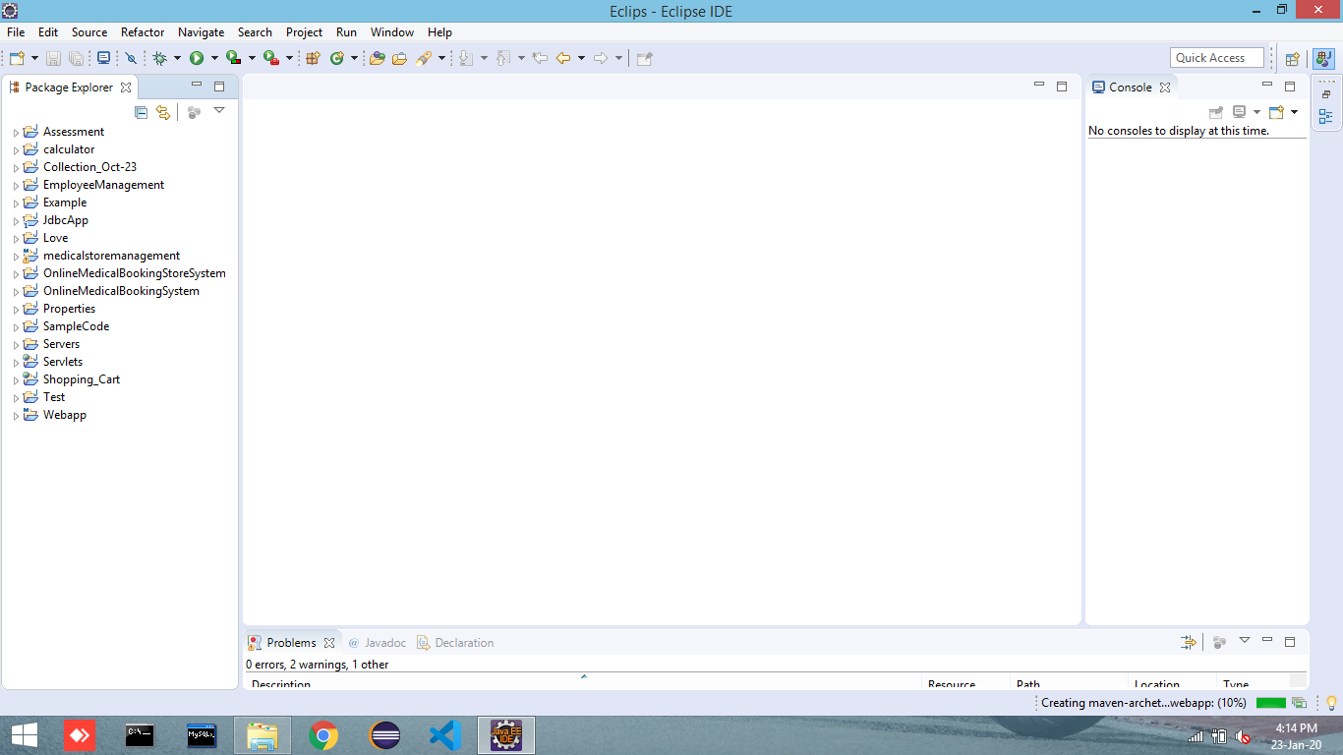
Open Eclips
Ctrl + N
Ctrl + N
Step 1 :

Slide 3
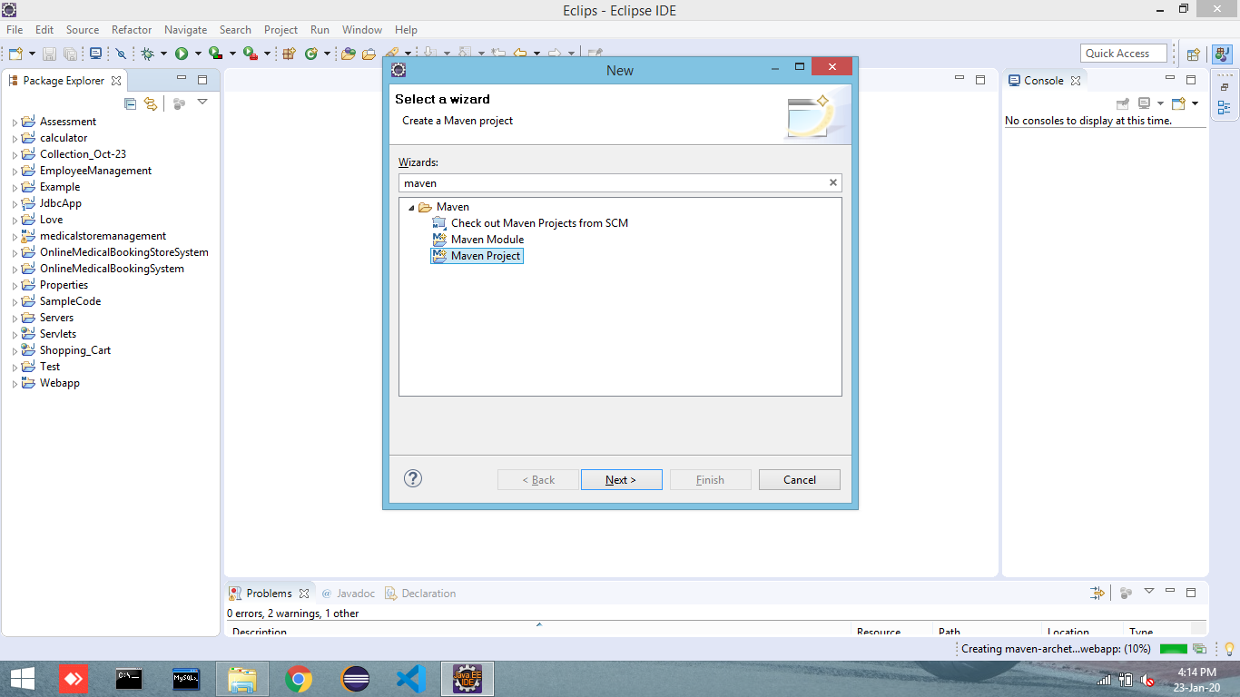
Ctrl + N

Slide 4
Type Maven Project

Slide 5
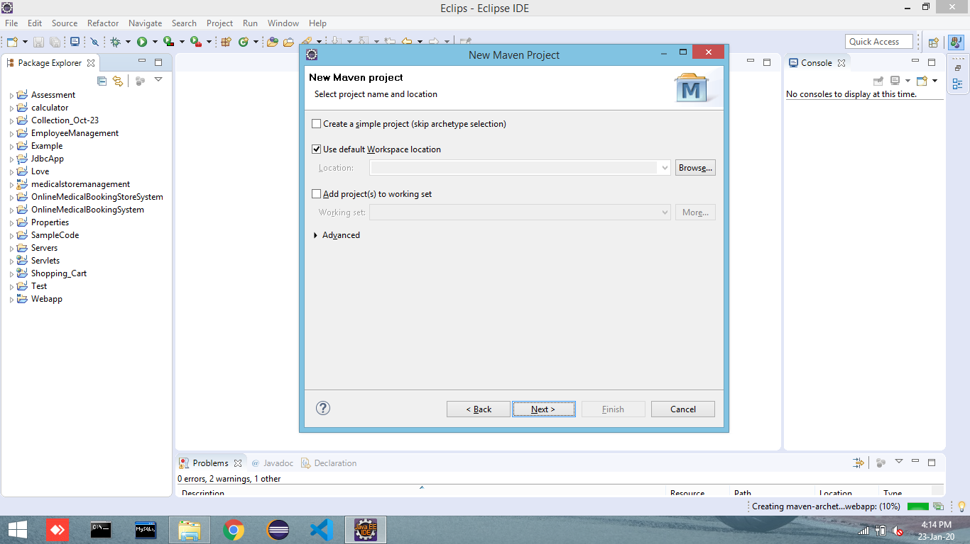
Next

Slide 6
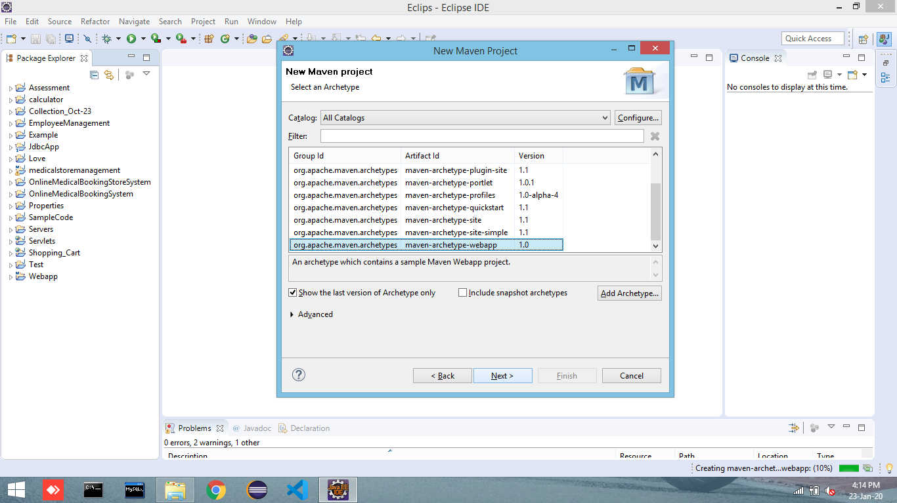
Select webapp Verion 1.0

Slide 7
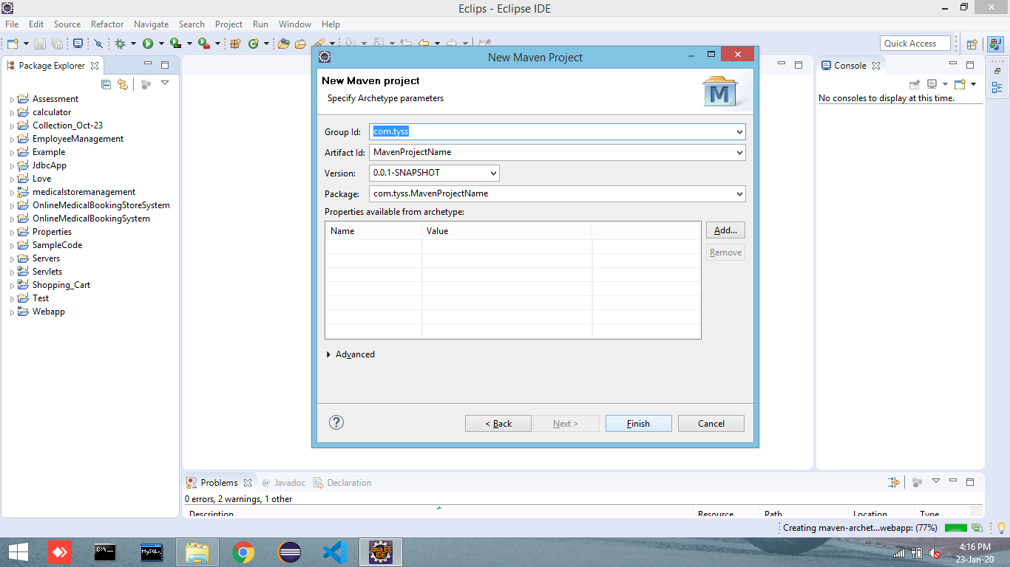
Give Group ID,Artifact Id and Finish

Slide 8


